Slide 1



Vision and requirements of mobile network beyond 2030
Dr. Guangyi Liu
5G Director，CTO of Wireless and Device，Fellow
China Mobile Research Institute

Slide 2

CONTENTS
I. Introduction
II. Vision and Scenarios beyond 2030
III. Network Performance Requirements Beyond 2030
IV. Network Features Beyond 2030

Slide 3


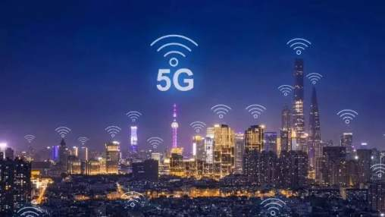


Introduction
Driving Applications and Requirements
The Dilemma of 5G
WHAT’S NEXT?

Slide 4
























Vision and Scenarios beyond 2030
Vision: Digital Twin, Ubiquitous Intelligence
Ubiquitous Intelligences
Interaction
Ubiquitous Sensing
Digital World
Physical World
Abstraction

Slide 5
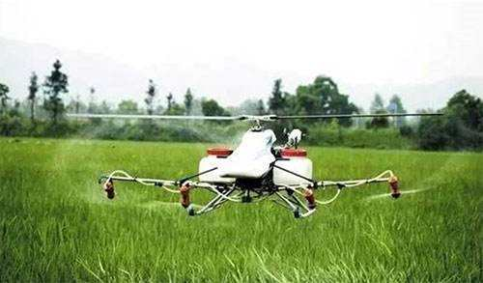
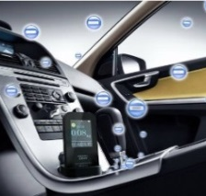
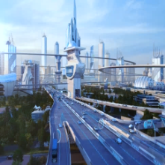







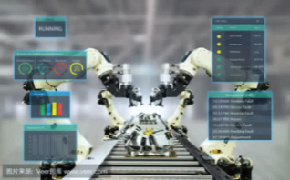

Vision and Scenarios beyond 2030
    Intelligent agriculture
    Intelligent industry
    Intelligent production
    Intelligent traffic
Precision medicine
    Intelligent interaction
    Intelligent society
    Intelligent life
Depopulated zone detection
    Twin body area network
Ubiquitous Intelligence
Virtual tour
    Synaesthesia internet

Slide 6

Vision and Scenarios beyond 2030
    Intelligent Life
    Synaesthesia Internet

Slide 7
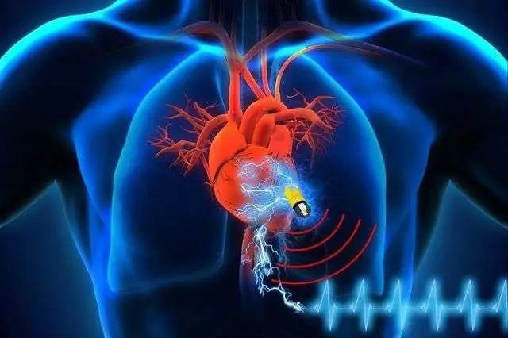

Vision and Scenarios beyond 2030
    Intelligent Life
    Twin Body Area Network
all-round monitoring of vital signs
nano-robot targeted therapy
pathological study
Twin “digital man”

Slide 8



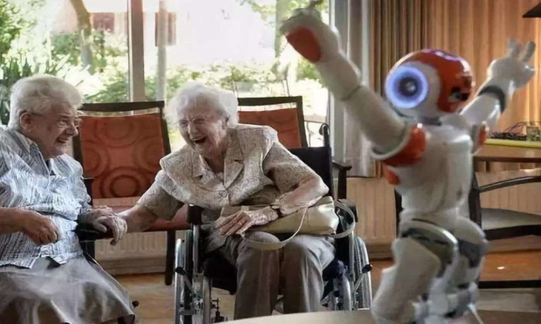

Vision and Scenarios beyond 2030
    Intelligent Life
    Intelligent Interaction
Learning ability sharing
Life skill replication
Mental development of children
Group care for the elderly

Slide 9
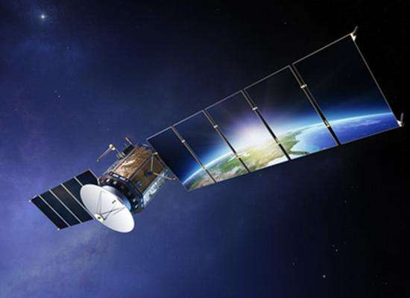
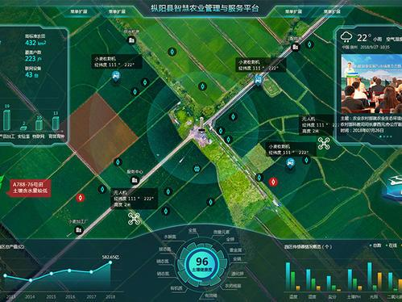

Vision and Scenarios beyond 2030
    Intelligent Production
    Intelligent Agriculture
Space agriculture
Agricultural production process simulation
Supply and demand balance

Slide 10
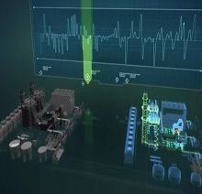
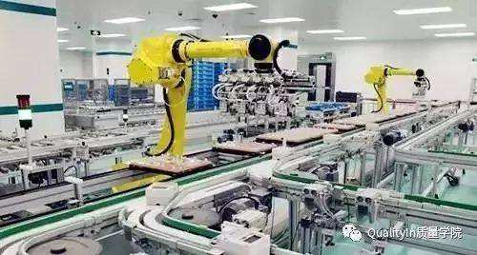
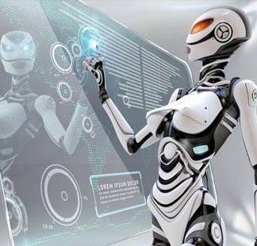
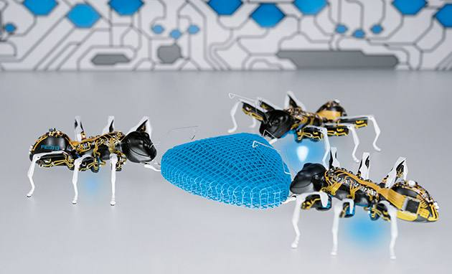
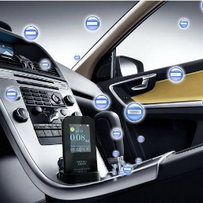
Vision and Scenarios beyond 2030
    Intelligent Production
    Intelligent Industry
Research in the digital world
Self-driven production
Intelligent production
Collaborative production
Nano-robots

Slide 11



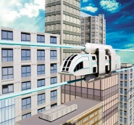





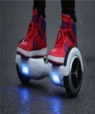

Vision and Scenarios beyond 2030
    Intelligent Society
    Intelligent Transportation
Air
Air-Ground-Sea integrated
multi-dimensional transportation
Flying cars
Personal aircraft
Air Bus
Ground
Customized and ultra-safe
Fully automatic driving
Sea-air aircraft
Underwater high-speed
Diving bus
flying saucer bus
Sea
Smart Segway

Slide 12



Vision and Scenarios beyond 2030
    Intelligent Society
    Universal Public Services
Educational resource sharing
Virtual tour
Precision medicine

Slide 13

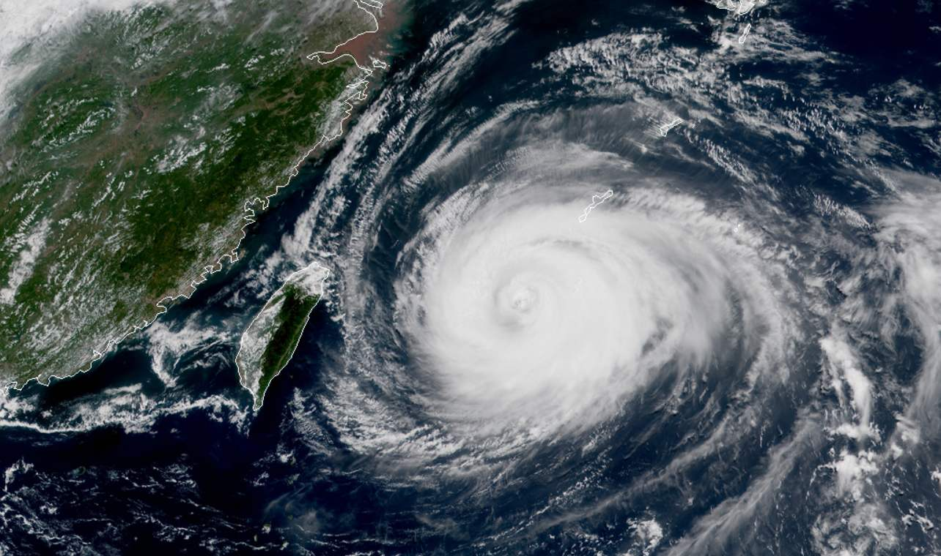
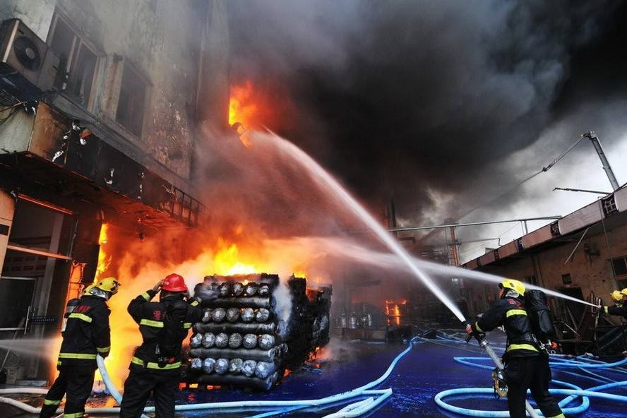
Vision and Scenarios beyond 2030
    Intelligent Society
    Refined Social Governance
Depopulated zone detection
Disaster prevention
Instant rescue

Slide 14

Network Performance Requirements Beyond 2030
Application Scenarios
Network performance indicator requirements
Potential enabling technologies
Peak data rates
Tbps level
OAM
    synaesthesia internet
User experience rate
Gbps level
Super-large scale antenna
Intelligent Life
Terahertz
    twin body area network
User plane latency
processing massive amounts of data in near real time
    intelligent interaction
VLC
Spectral efficiency
2~3 times higher than 5G
New coding &modulation
Intelligent production
    Intelligent agriculture
full-frequency access
Capacity density
10-1000 times higher than 5G,
three-dimensional coverage
    Intelligent industry
Space-air-groud integrated network
Connection density
10-1000 times higher than 5G,
three-dimensional coverage
Intelligent society
    Super smart Transportation
Bionic learning network
    precision medicine
Mobility
> 1000km/h
Soft network
    instant rescue
    "no man's land" detection
    …
Reliability
Cable transmission level reliability
AI
New capability indicator
ultra-high positioning accuracy
（sub-meter）
ultra-low delay jitter
ultra-high security
Molecular communication
Trusted Computing

Slide 15
Network Features Beyond 2030
On-demand Fulfillment Network
Ultimate performance
Soft Network
Lite Network
Plug-and-play, Easy to deploy
Software defined, Customizable, Self-evolving
Native AI
Native Security
Intelligent consensus on information,
Smart defense of network
ICDT convergence
Intelligent node
Intelligent connection
Zero touch network

Slide 16

Network Features Beyond 2030
On-demand Fulfillment Network
Peak Data Rate
User Experienced Data Rate
Diverse capabilities
Latency
Ultra Low Jitter
Connection Density
3D Coverage
Area Traffic Capacity
Ultra High Security
Super Accurate Positioning
Volume Spectrum Efficiency
Network Energy Efficiency
Mobility

Slide 17

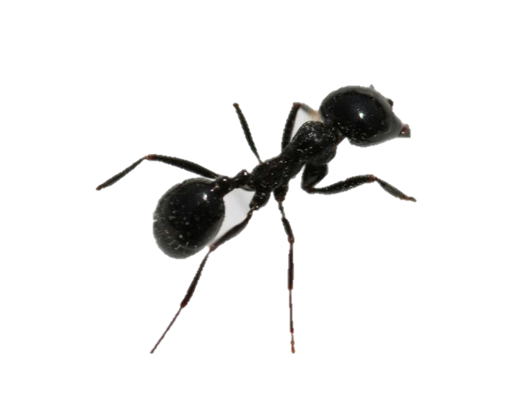

Network Features Beyond 2030
Lite Network
Plug and Play, easy to deploy
NSSF
NRF
Simple architecture
SMF
PCF
Slice #1
UPF
PDU session 1#
DN1
PCF
NRF
SMF
PCF
Slice #2
AMF
UPF
PDU session 2#
DN2
Common NF slices #1 & #2
AN
NRF
Slice #3
SMF
PCF
AMF
UPF
PDU session 3#
DN3
Swarm intelligence
Elastic capacity expansion and fast upgrade
BUT
Complicated network
Network slicing
NFV/SDN
…

Slide 18







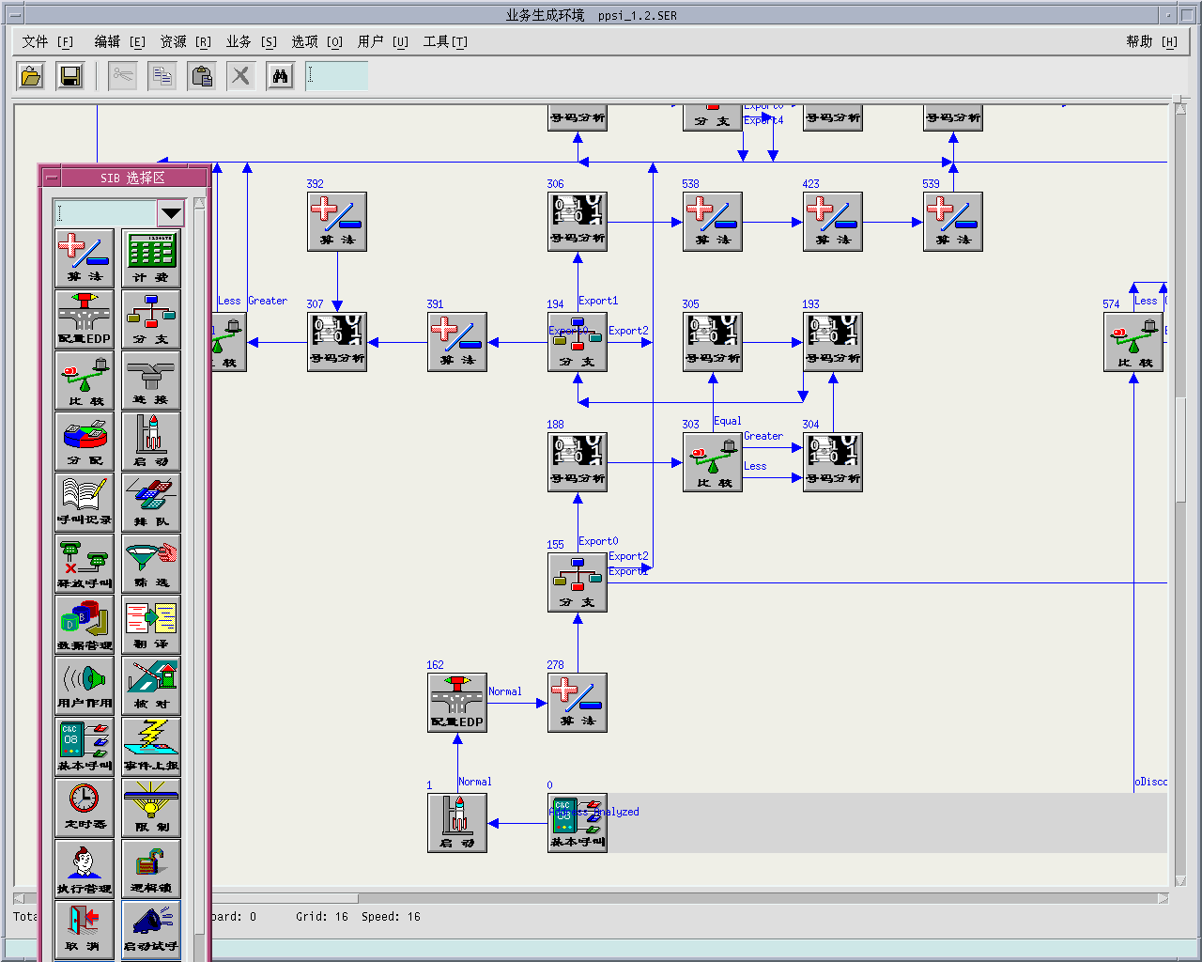
Network Features Beyond 2030
Soft Network
Fully software-defined
Self evolving
Customized
Open air-interface & softwarized terminals
Flexible, fast SW & HW extension
Agile development iterations
Self-learning-based new features & functionalities enablement
Automatical upgrade of E2E NW
User-centric network
auto-configuration
UE
gNB
Service

Slide 19











Network Features Beyond 2030
Native AI
Intelligent Device
Edge AI
Intelligent network entity
Distributed AI
Intelligent OAM
Central AI
AI platform
AI crowd funding
Capabilities
openess
customers、vertical app
Virtualized Core
Cloud APP
platform
AI decision
Requirement
mapping
MEC
CU
Cloud Radio
DU
Cloud big data
platform
Eco-system
management
AAU

Slide 20
Network Features Beyond 2030
Native Security
Smart Consensus
AI enabled Defense
Safeguard data and information security based on consensus achieved by connected smart entities
Proactive in-depth defense, based on AI and Big Data technology
AI
Trust Enhancement
Ubiquitous Cooperation
Infrastructure with active immunity via trustworthy computing technology
Collaborative security assessment and resolution across terminal, edge, network, and cloud.

Slide 21

THANK YOU

